Slide 1

WORKING IN SPAIN IN THE DIGITAL AGE
—
Lavorare in Spagna nell’era digitale
Working in Spain in the digital age
FEBRUARY 2023

Slide 2
WORKING IN SPAIN IN THE DIGITAL AGE
INDEX
Context
Profile
The Market
Rates
Structures
COAC / Orderi dei Architetti
Conclusions
—

Slide 3

WORKING IN SPAIN IN THE DIGITAL AGE
CONTEXT
INTRODUCTION
—

Slide 4

WORKING IN SPAIN IN THE DIGITAL AGE
6 Universities ->
(Tarragona, Girona, Barcelona 4 (2 public + 2 private)
Average of students graduated per year -> 400 students
Average years to complete degree -> 8 years (19 – 27/28)
Master in Architecture -> Necessary to sign a project
Mandatory -> Associate to COAC (11,000 associates)
(Ordine degli architetti – Catalonia)
CONTEXT
INTRODUCTION
—

Slide 5

WORKING IN SPAIN IN THE DIGITAL AGE
PROFILE
INTRODUCTION
—

Slide 6
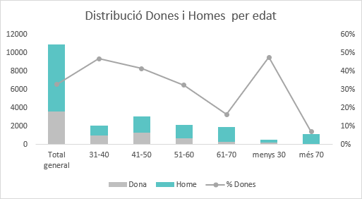
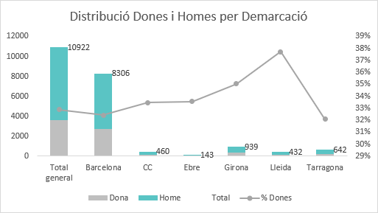
WORKING IN SPAIN IN THE DIGITAL AGE
Distribution Women and Men by age
PROFILE
40% of our Associates are women under 50 years
ASSOCIATE ARCHITECTS PROFILE
Distribution Women and Men by region
70% of our Associates work in Barcelona
—

Slide 7
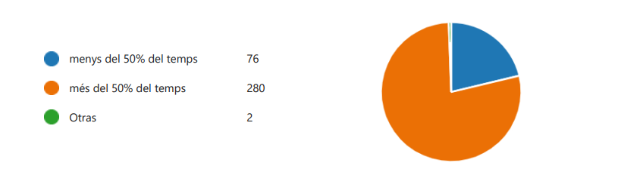
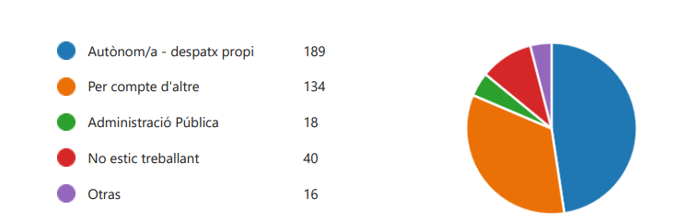
WORKING IN SPAIN IN THE DIGITAL AGE
How much time do you dedicate to your architecture profession?
25% of our Associates work outside the field of architecture
PROFILE
Less than 50% time
More than 50% time
47% of our Associates work as a freelancer
PROFESSIONAL ROLES
What is your professional role?
33% of our Associates work for a studio or company
Self employed/ Own studio
Private company
Public administration
Currently not working
About 1,100 architects/year are looking for a job opportunity
—

Slide 8
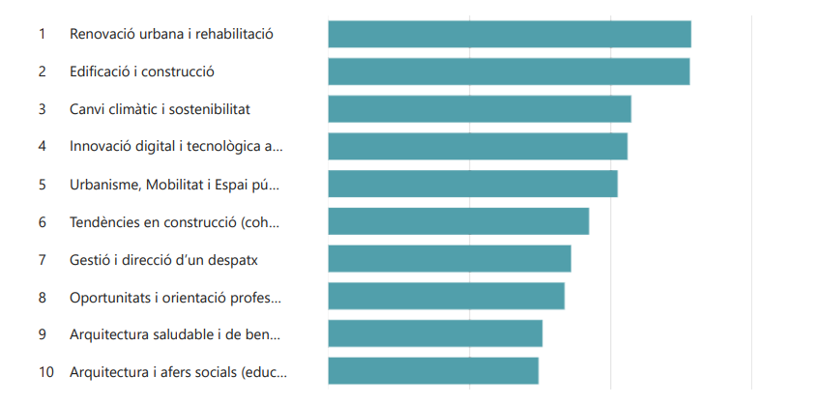
WORKING IN SPAIN IN THE DIGITAL AGE
PROFILE
INTERESTS
75% of our Associates are interested in:
Urban Regeneration Building
Construction
55% of our Associates are interested in:
Environmental Sustainability
—
OTR / OTC
COAC
Informative sessions about decarbonisation: challenges and opportunities
COAC

Slide 9

WORKING IN SPAIN IN THE DIGITAL AGE
THE MARKET
INTRODUCTION
—

Slide 10
WORKING IN SPAIN IN THE DIGITAL AGE
Architecture Studios
Project Management
THE MARKET
Urban Regeneration
Data Analyst - Urban Planning
Refurbishing / Restoration
PROFFESIONAL OPPORTUNITIES:
TRENDS
Specialised services
Retail
Industrial Design applied to Housing
Architecture Cooperatives
—
Facility Management
VR / AR / Metaverse

Slide 11
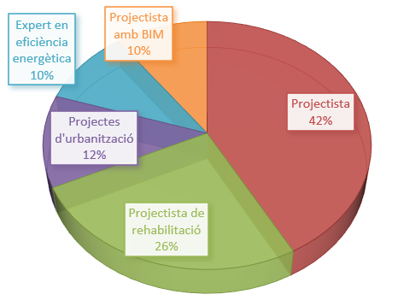
WORKING IN SPAIN IN THE DIGITAL AGE
Companies demand (privat clients or B2C)
42% -> “traditional architect”
58% -> new generations
THE MARKET
58% new inquires
10%
BIM MANAGER
THE MARKET:
COMPANIES
B2B
10%
Energy Efficiency Advisor
12%
Urban Regeneration
—
26%
Refurbishing Advisor

Slide 12
WORKING IN SPAIN IN THE DIGITAL AGE
Citizen demand (privat clients or B2C)
60%
1st_Energy Efficent Renovation
2nd_Subsidy Management (Next Generation)
7%
3rd_Design and Construction Management
6%
4th_Energy Certificates for Buildings
5%
5th_Facility Management + Renovation & Refurbishment
6th_ Activity Licence/Permit + Use Change
4%
7th _Habitability Certificate or First Occupancy Licence.
2%
8th_ ITE, Technical Inspections of the Building
THE MARKET
Ciutadans que han demanat arquitecte | Nombre | %
Projectes i Direcció d'obra | 13 | 7,74%
Rehabilitació i manteniment d’edificis | 9 | 5,36%
Informes i certificats | 8 | 4,76%
ITE, Inspecció Técnica d’Edifici | 4 | 2,38%
Rehab. energètica, Gestió subvencions, NEXT Generatión | 107 | 63,69%
Certificat energètic | 11 | 6,55%
Cèdula d'habitabilitat | 7 | 4,17%
Llicència d'activitats Canvi d'us | 9 | 5,36%
TOTAL CIUTADANS DEMANAT UN ARQUITECTE | 168
THE MARKET:
PRIVAT CLIENT
B2C
—

Slide 13

WORKING IN SPAIN IN THE DIGITAL AGE
RATES WORK
INTRODUCTION
—

Slide 14
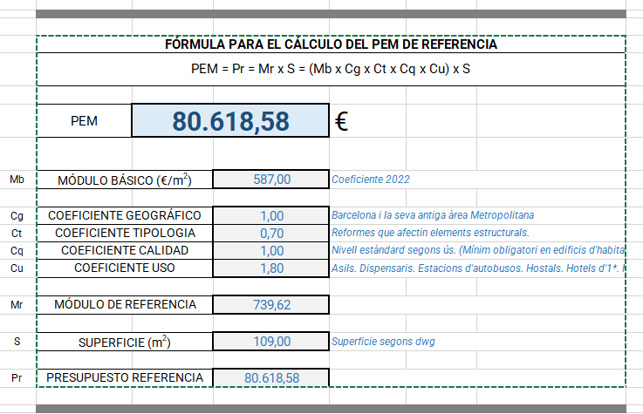
WORKING IN SPAIN IN THE DIGITAL AGE
Privat Clients -> Unit rate estimating
a) 8%-10% del PEM
b) COAC Module to calculate PEM Mb = 587,00 €/m2
Public Administration Clients -> No approximate rates.
a) – 1,5% to -5% reduction fee
From COAC we cannot suggest fee scales due to the competition act.
RATES WORK
ESTIMATION
—

Slide 15
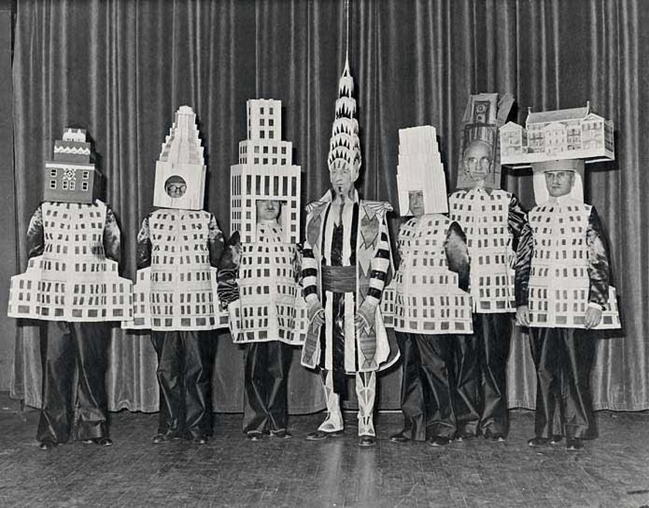
WORKING IN SPAIN IN THE DIGITAL AGE
STRUCTURES
INTRODUCTION
—

Slide 16
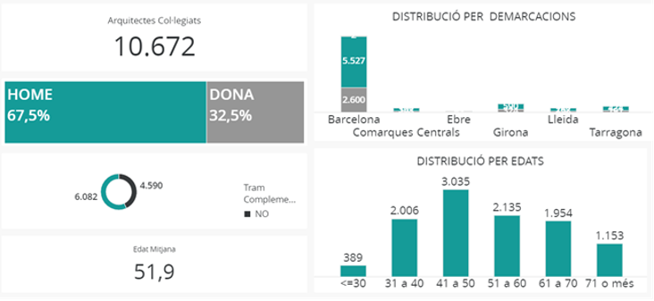
WORKING IN SPAIN IN THE DIGITAL AGE
Associate’s profile (company structure):
-> 80% of studios: freelance – 2 or 3 workers
-> 20% architecture companies: 25 – 85 workers
Regional data -> 85% located in Barcelona
50% of our associates are under 45 years
STRUCTURES
ARCHITECTS
Studios/Companies
—

Slide 17

WORKING IN SPAIN IN THE DIGITAL AGE
I’m an architect! I want to work on my own and I have a viable project; What should I do?
FIRST STEPS
01. Decide whether to be a self employed or start a company
02. Register your Activity and in the IAE, if applicable
03. Insurance “Civili Liability” (RESPONSABILITAT CIVIL)
04. Registration at HNA o RETA (Social Security/ Seguridad Social).
05. Register as an associate at COAC
06. If you have employees, you must know:
a) Workers must be registered at RETA
b) Workers must have contracts
07. Legalize the Accounting records.
08. Register the opening of your studio
09. Hire an accountant and/ or legal Consultant
STRUCTURES
HOW TO BE A FREELANCE ARCHITECT?
Oficina d’Ocupació / Employment Office
COAC
—

Slide 18
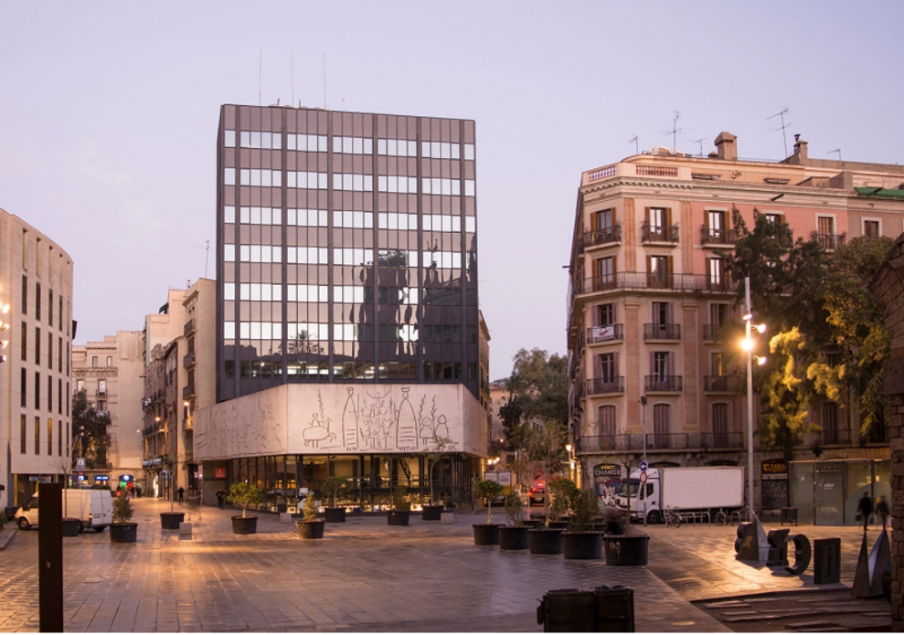
WORKING IN SPAIN IN THE DIGITAL AGE
THE COAC
INTRODUCTION
—

Slide 19

WORKING IN SPAIN IN THE DIGITAL AGE
Architect Start-up Office / (How to start your activity?)
Employment Service
Escola SERT
Job offers and openings
Professional Career Guidance
Entrepreneurship
COAC
HOW CAN WE HELP YOU?
—

Slide 20
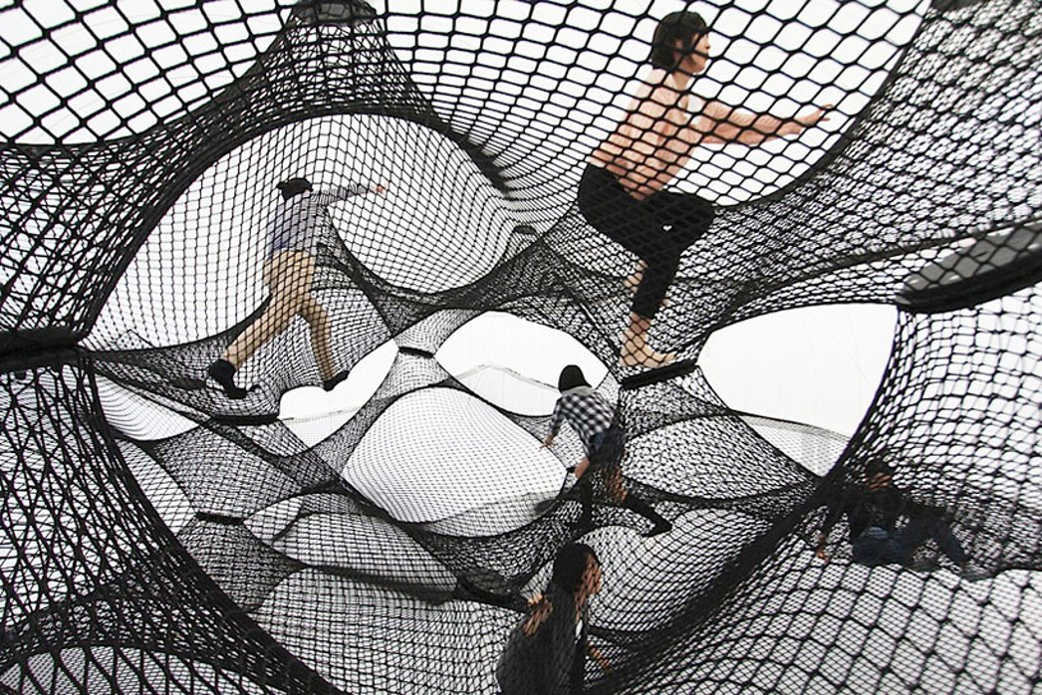
WORKING IN SPAIN IN THE DIGITAL AGE
CONCLUSIONS
OVERVIEW
—

Slide 21
WORKING IN SPAIN IN THE DIGITAL AGE
CONCLUSIONS
Profiles 50% under 45 - 50% over than 45
Market opportunities = Urban Regeneration / Refurbishing / Energy Efficiency
Mòdul ref 587 €/m2 COAC + 8-10% PEM
COAC Services – Career Guidance / Entrepreneurship / Job Board -> Architect Start Up Office (How to start your activity as an architect?)
OVERVIEW
—

Slide 22
WORKING IN SPAIN IN THE DIGITAL AGE
—
Grazie mille

